Slide 1
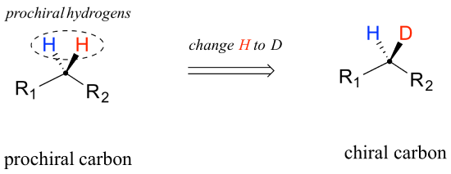
Chiral And Prochiral Molecule

Slide 2
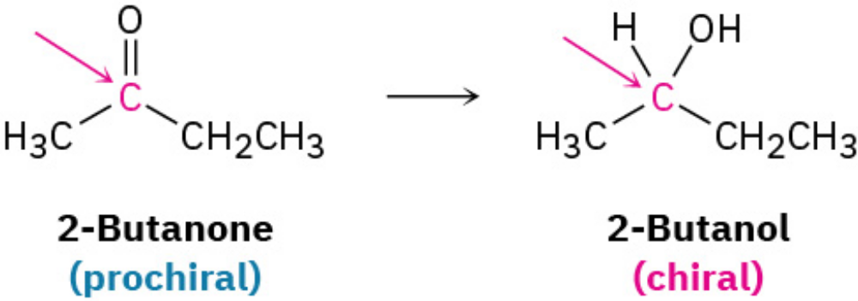
Prochirality
Closely related to the concept of chirality, and particularly important in biological chemistry, is the notion of prochirality.
A molecule is said to be Prochiral if it can be converted from achiral to chiral in a single chemical step.
For instance, an unsymmetrical ketone like 2-butanone is prochiral because it can be converted to the chiral alcohol 2-butanol by the addition of hydrogen.

Slide 3
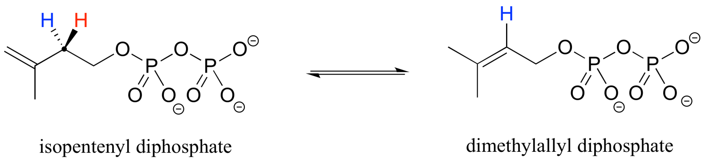
Importance Of Prochirality
Prochirality is an important concept in biological chemistry, because enzymes can distinguish between the two ‘identical’ groups bound to a prochiral carbon center due to the fact that they occupy different regions in three-dimensional space. Consider the isomerization reaction below, which is part of the biosynthesis of isoprenoid compounds.
The isomerase enzyme is able to distinguish between the prochiral 'red' and the 'blue' hydrogens on the isopentenyl diphosphate (IPP) substrate. In the course of the left to right reaction, IPP specifically loses the 'red' hydrogen and keeps the 'blue' one.

Slide 4
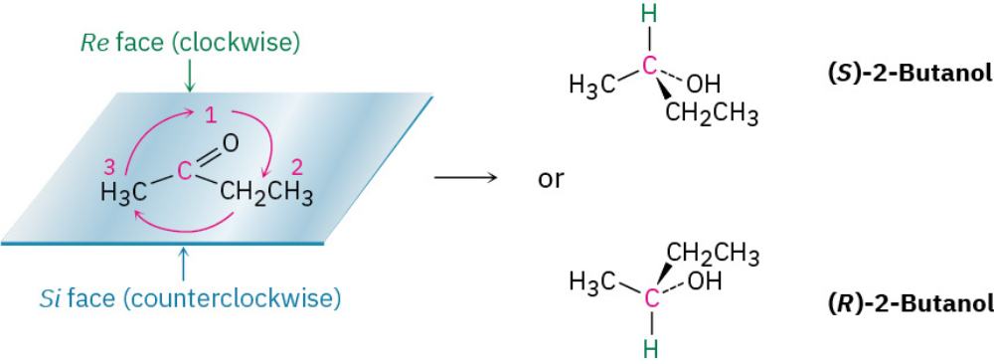
Enantiomer of 2-butanol is produced depends on which face of the planar carbonyl group undergoes reaction.
To distinguish between the possibilities, the stereochemical descriptors Re and Si. Rank the three groups attached to the trigonal, sp²-hybridized carbon.
The face on which the arrows curve clockwise is designated the Re face (similar to R), and the face on which the arrows curve counterclockwise is designated the Si face (similar to S). In this example, addition of hydrogen from the Re face gives (S)-2-butane, and addition from the Si face gives (R)-2-butanol.

Slide 5
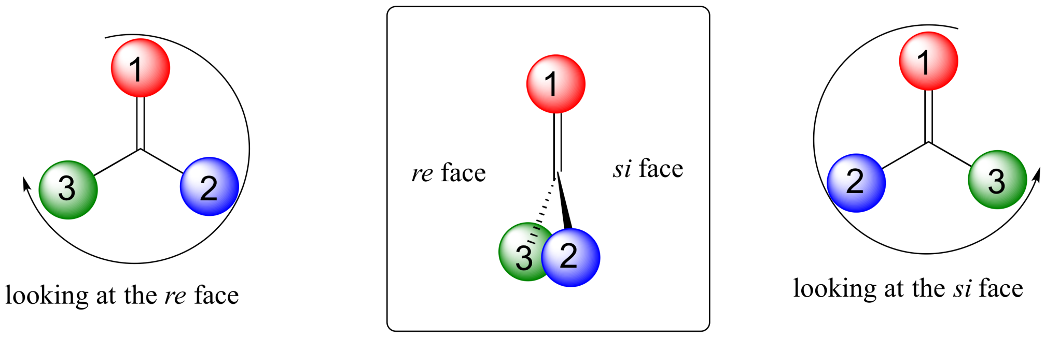

Slide 6
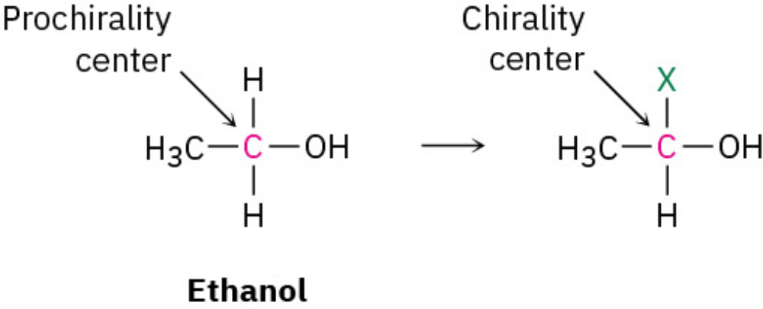
Compounds with planar, sp²-hybridized atoms, compounds with tetrahedral, sp³-hybridized atoms can also be prochiral. An sp3-hybridized atom is said to be a prochirality center if, by changing one of its attached groups, it becomes a chirality center. The −CH₂OH carbon atom of ethanol, for instance, is a prochirality center because changing one of its attached −H atoms converts it into a chirality center.
Prochirality

Slide 7
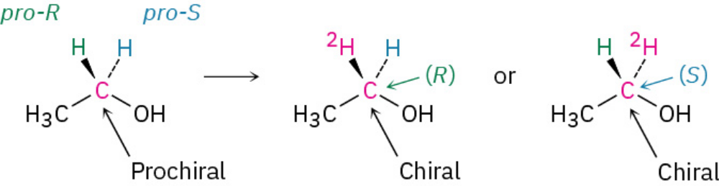
pro-R & pro-S
Of the two identical atoms in the original compound, the atom whose replacement leads to an R chirality center is said to be pro-R and the atom whose replacement leads to an S chirality center is pro-S.

Slide 8
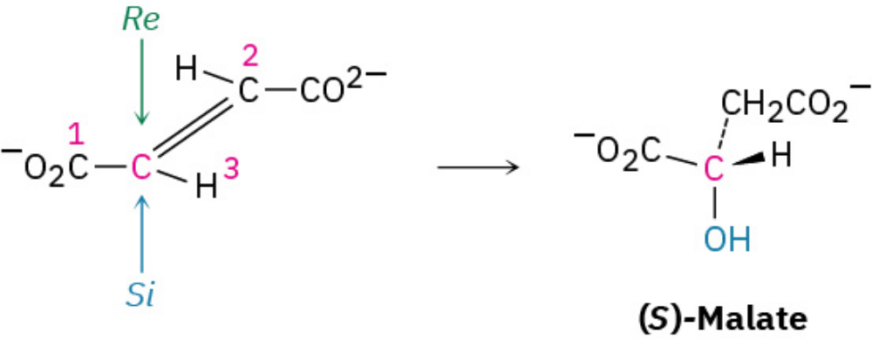
Biological Prochirality
A large number of biological reactions involve prochiral compounds. One of the steps in the citric acid cycle by which food is metabolized, for instance, is the addition of H₂O to fumarate to give malate. Addition of −OH occurs on the Si face of a fumarate carbon and gives (S)-malate as product.

Slide 9
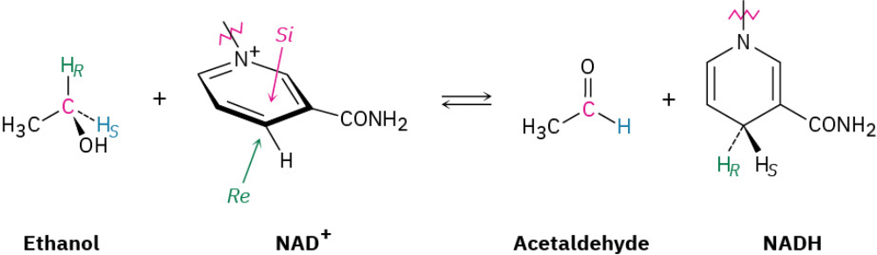
As another example, studies with deuterium-labeled substrates have shown that the reaction of ethanol with the coenzyme nicotinamide adenine dinucleotide (NAD⁺), catalyzed by yeast alcohol dehydrogenase, occurs with exclusive removal of the pro-R hydrogen from ethanol and with addition only to the Re face of NAD⁺.

Slide 10
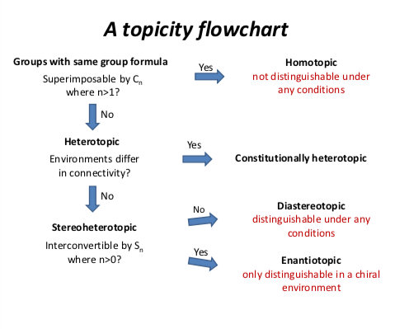
Topicity In Stereochemistry
In stereochemistry, topicity is the stereochemical relationship between substituents and the structure to which they are attached. Depending on the relationship, such groups can be heterotopic, homotopic, enantiotopic, or diastereotopic.

Slide 11
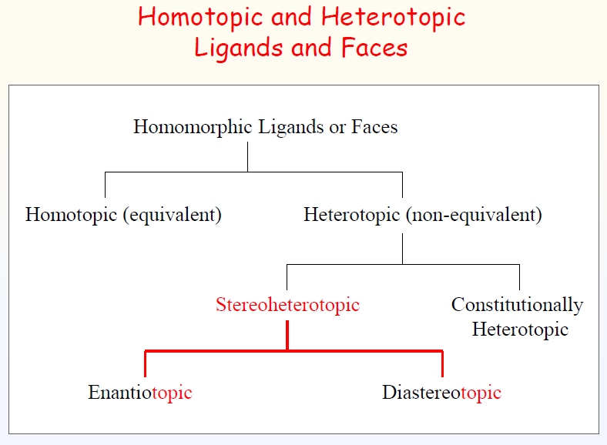

Slide 12
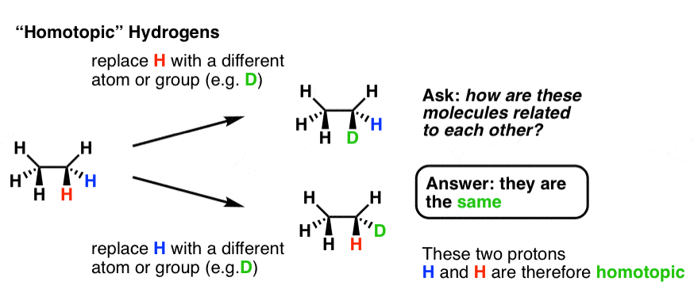

Slide 13
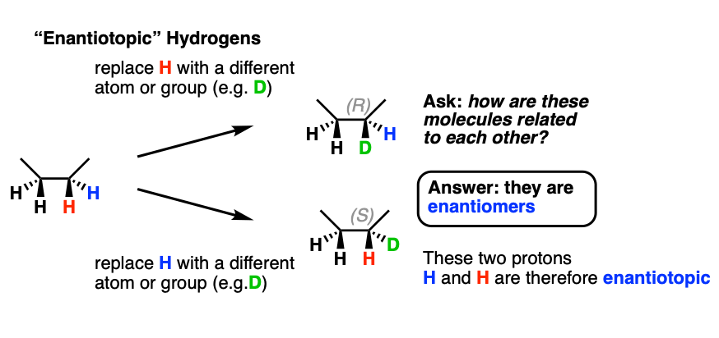

Slide 14
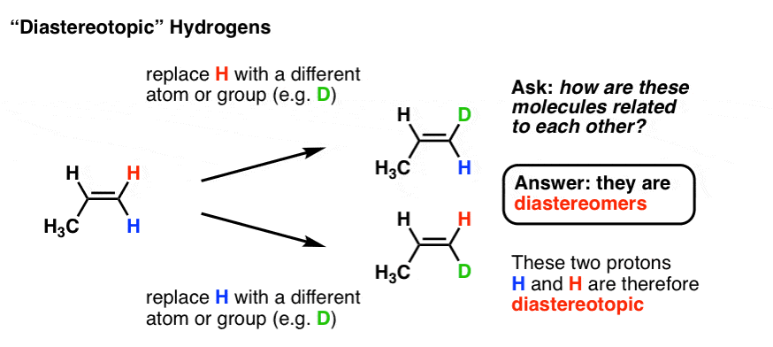

Slide 15
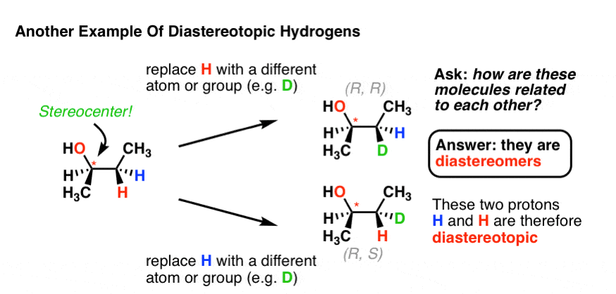

Slide 16
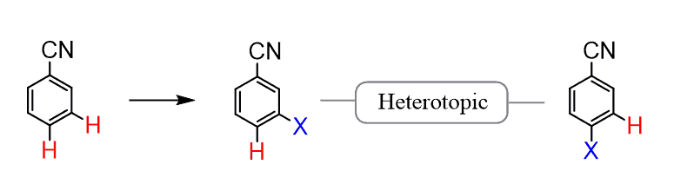
In this case, they are still chemically not equivalent but specifically, these are a pair of (constitutionally) heterotopic protons.
For example, replacing the following two protons with another group gives two constitutional isomers, which is why they are called constitutionally heterotopic or simply heterotopic protons.

Slide 17
Hetero topic Ligands
Two or more ligands that are identical when viewed in isolation but individual replacement of two identical ligands by another ligand give rise to two structurally different (isomeric) molecules, then they are called hetero topic ligands.
Constitutionally Hetero topic ligands
Constitutionally Hetero topic Ligands
Two or more ligands in a molecule that are identical on individual replacement by another ligand give rise to two molecules that constitutional isomer of each other, then the original two ligands are said to be constitutionally heterotopic ligands

Slide 18
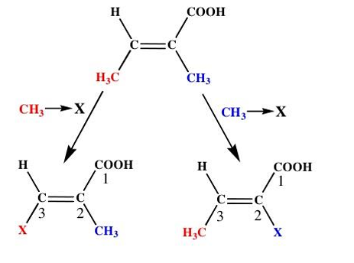

Slide 19
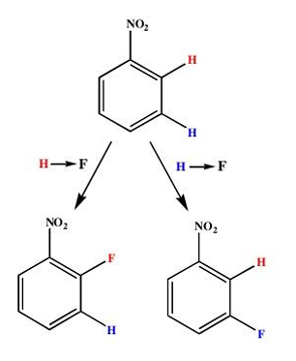

Slide 20
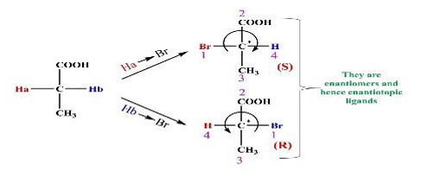
Stereo Chemically heterotopic
Two or more ligands in a molecule that are identical on individual replacement by another ligand give rise to that are enantiomers then the original ligands are said to be enantiotopic ligands.

Slide 21
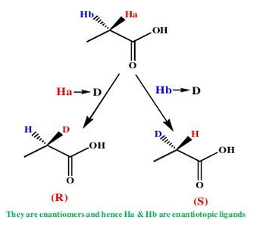

Slide 22
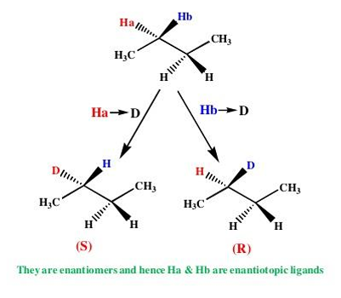

Slide 23
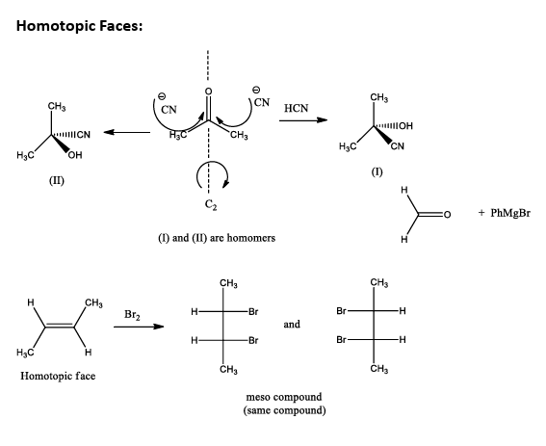

Slide 24
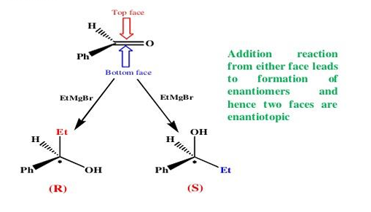
Enantiotopic faces
Two faces of pi system or a double bond are enantiotopic if addition or either face gives enantiomeric product.

Slide 25
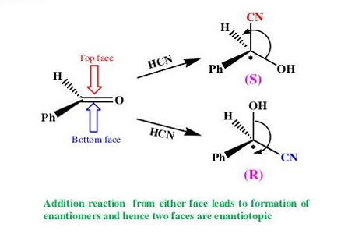

Slide 26
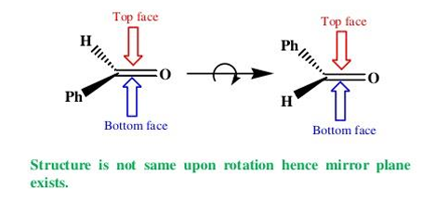
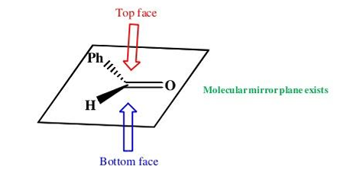

Slide 27
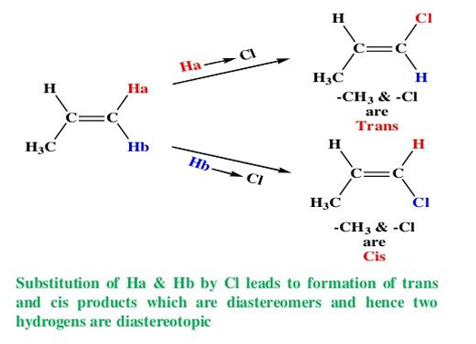
Diastereotopic Ligands
Two or more ligands in a molecule that are identical on individual replacement by another ligand give rise to that are diastereomers, then the original ligands are said to be enantiotopic ligands.

Slide 28
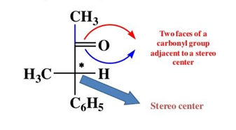
Diastereotopic faces
Two faces of carbonyl group adjacent to a stereo center upon addition reaction leads to diastereomers and process diastereotopic face.

Slide 29
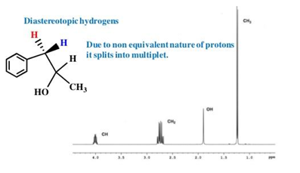

Slide 30
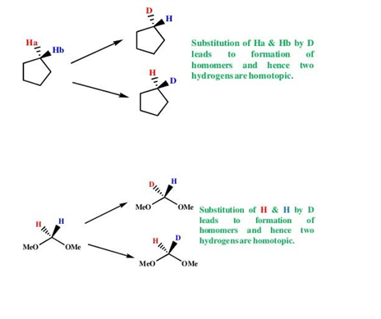

Slide 31
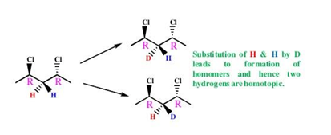
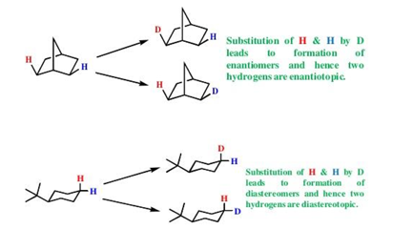

Slide 32
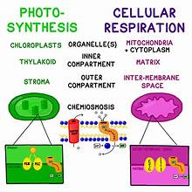

Slide 33
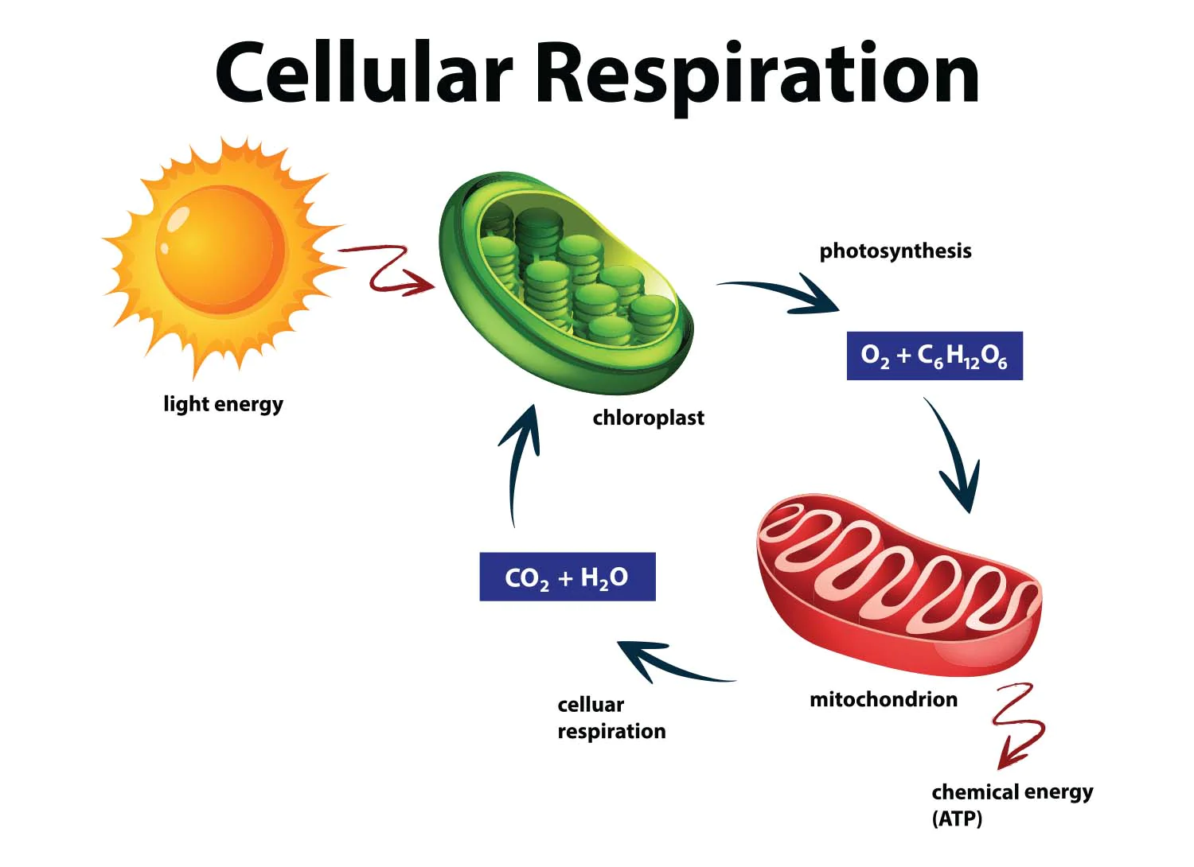

Slide 34
Cellular respiration
Cellular respiration is the process of oxidizing biological fuels using an inorganic electron acceptor, such as oxygen, to drive production of adenosine triphosphate (ATP), which stores chemical energy in a biologically accessible form.
Cellular respiration may be described as a set of metabolic reactions and processes that take place in the cells to transfer chemical energy from nutrients to ATP, with the flow of electrons to an electron acceptor, and then release waste products.

Slide 35
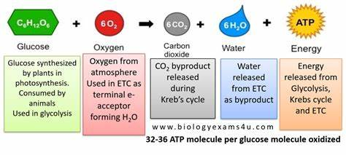

Slide 36
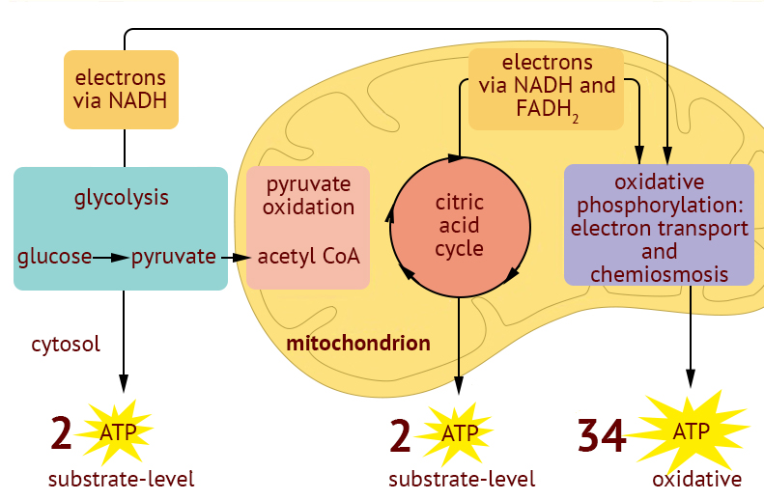
Cellular respiration

Slide 37
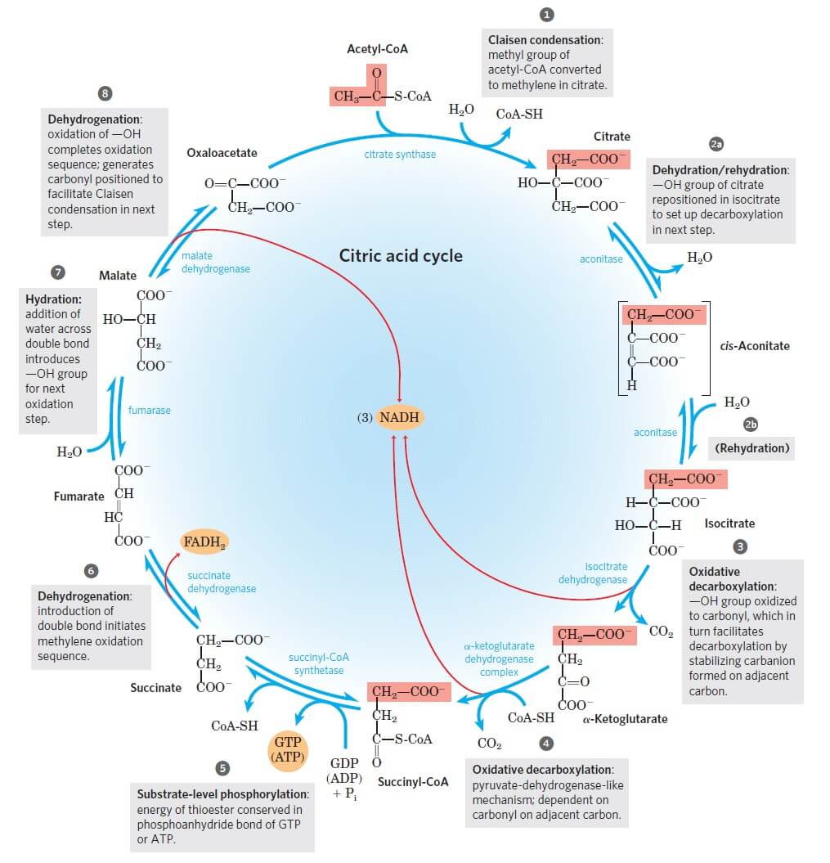

Slide 38
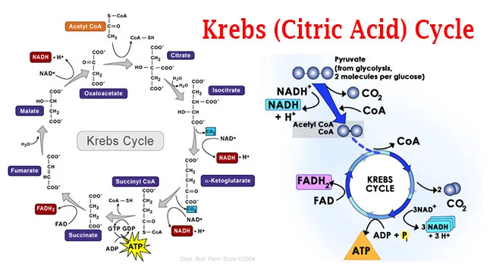
acetyl CoA + 3 NAD + FAD + ADP + HPO₄⁻² —————> 2 CO₂ + CoA + 3 NADH⁺ + FADH⁺ + ATP

Slide 39
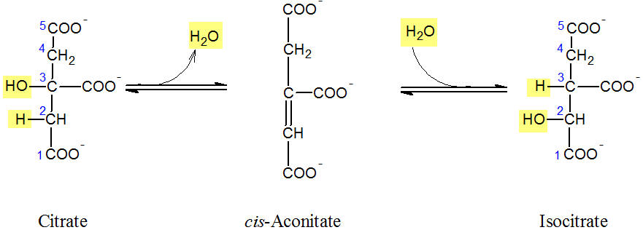
In the second reaction of the Krebs cycle, the isomerisation of citrate to isocitrate takes place. As an intermediate, cis-aconitate is formed.
This conversion is of utmost importance for the subsequent decarboxylation, because a tertiary alcohol (the citrate) can not be directly oxidized to a keto carboxylic acid.

Slide 40
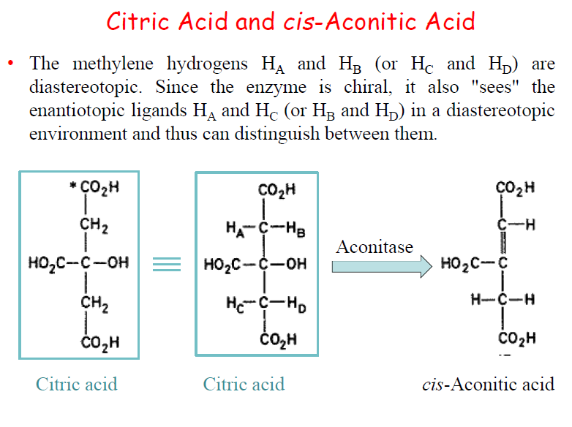

Slide 41
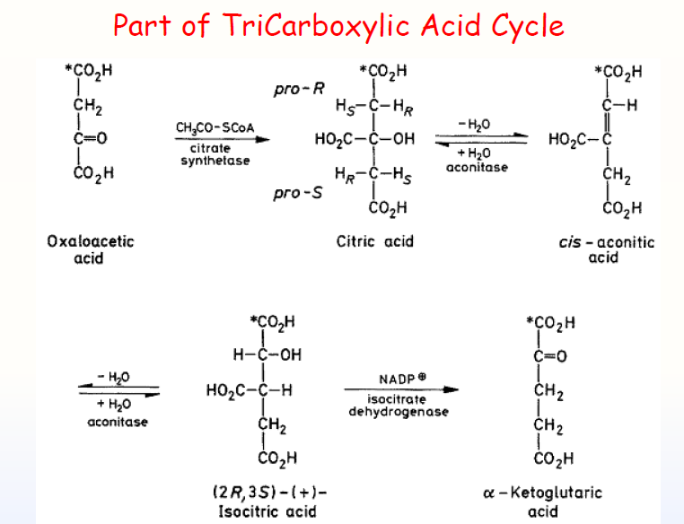

Slide 42
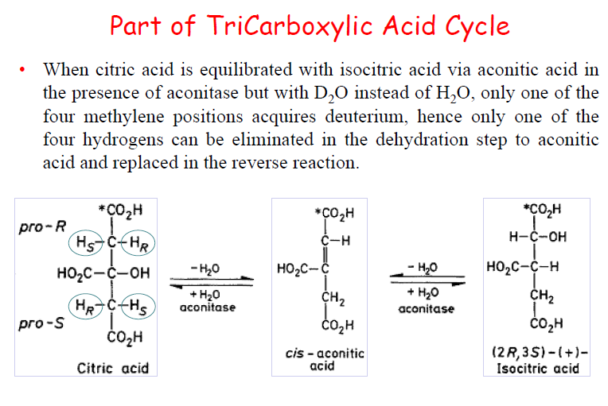

Slide 43
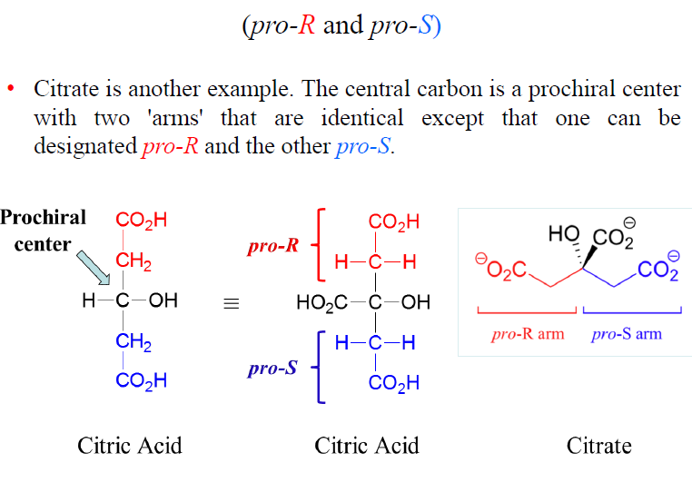

Slide 44
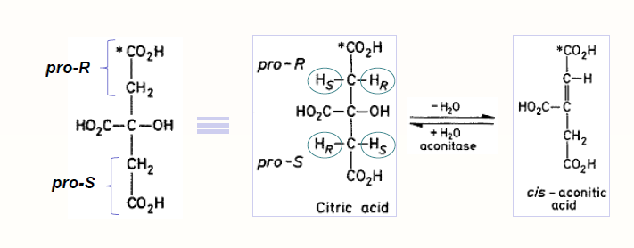

Slide 45
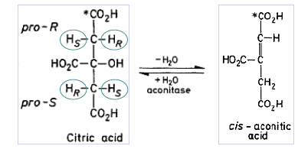
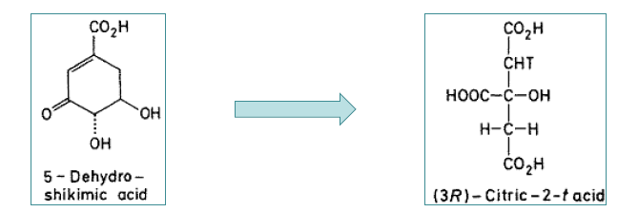

Slide 46
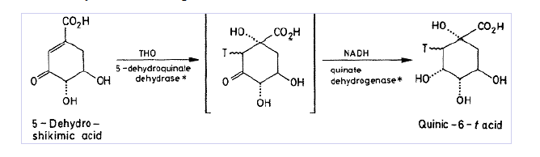
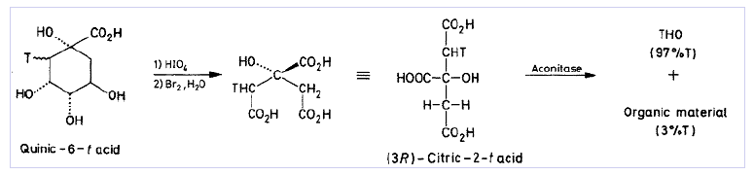

Slide 47
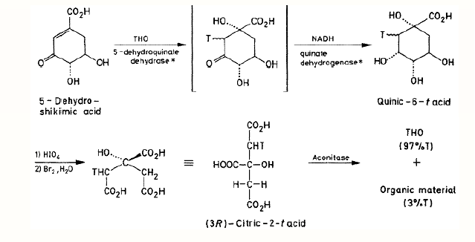

Slide 48
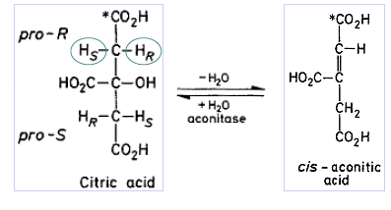


Slide 49


Slide 50


Slide 51
Heterotopicity and Enzyme catalyst Reaction

Slide 52


Slide 53

Note that the hydroxyl-bearing carbon of citrate is a prochirality center and contains two identical arms. Because the initial aldol reaction of acetyl CoA to oxaloacetate occurs specifically from the Si face of the ketone carbonyl group, the pro-S arm of citrate is derived from acetyl CoA and the pro-R arm is derived from oxaloacetate

Slide 54


Slide 55

Determining the stereochemistry of reactions at prochirality centers is a powerful method for studying detailed mechanisms in biochemical reactions. As just one example, the conversion of citrate to cis-aconitate in the citric acid cycle has been shown to occur with loss of a pro-R hydrogen, implying that the OH and H groups leave from opposite sides of the molecule.

Slide 56

A large number of biological reactions involve prochiral compounds. One of the steps in the citric acid cycle by which food is metabolized, for instance, is the addition of H₂O to fumarate to give malate. Addition of −OH occurs on the Si face of a fumarate carbon and gives (S)-malate as product.

Slide 57


Slide 58


Slide 59

As another example, studies with deuterium-labeled substrates have shown that the reaction of ethanol with the coenzyme nicotinamide adenine dinucleotide (NAD+), catalyzed by yeast alcohol dehydrogenase, occurs with exclusive removal of the pro-R hydrogen from ethanol and with addition only to the Re face of NAD+.

Slide 60

Biological reduction

